Slide 1

FPGA Implementation of Educational RISC-V
SIMD Array Processor.
Supervised By
Nahin Ul Sadad
Assistant Professor
Dept. of Computer Science & Engineering, RUET.
Presented by
Md. Firoz Al Mamun
Roll: 1703117
Nadim Mahmud Reyal
Roll:1803116

Slide 2
Outline
Literature Review
Thesis Objectives
❏ Background Study
Top Architecture
Proposed Methodology
❏ Tools
❏ Conclusion
Future Work
❏ References
November 27, 2023 Optimizing CPU Performance through SIMD Array Processing Unit 1/15

Slide 3
Literature Review
Paper Name | Year | Used Method & Result
FPGA Implementation of Educational RISC-V Processor Suitable for Embedded Applications[1] | 2023 | 16 Bit CPU. RISC-V Architecture . Assembler. Limitations: Generalizability of design Comparison with other educational processors
A Minimal RISC-V Vector Processor for Embedded Systems[2] | 2020 | 32-bit CPU RISC-V Architecture Vector ALU & Registers Limitation: Limited Vector Size -> Limiting the length of vector Resource Utilization , Scability & programming overhead
FPGA based MIPS Pipeline Processor With SIMD Architecture[3] | 2018 | 32-bit MIPS Processor MIPS SIMD Architecture Limitation: Hardware-specific implementation Lack of comparison with other SIMD architectures Future directions
November 27, 2023 Optimizing CPU Performance through SIMD Array Processing Unit 2/15

Slide 4
Literature Review
Paper Name
Year
User Method & Result
CPU Design Simplified[4] | 2018 | Very Simple CPU (VSCPU). 16 bit ISA. It is a multi-cycle CPU. Limitation: Level of details Comprehensiveness Practically
Design and Performance Analysis on Static and Dynamic Pipelined CPU in Course Experiment of Computer Architecture[5] | 2018 | Static pipelined CPU Dynamic pipelined CPU. Limitation: Limited Scope Evaluation Methodology Comparative analysis Educational Impact Future directions
November 27, 2023 Optimizing CPU Performance through SIMD Array Processing Unit 3/15

Slide 5
Thesis Objectives
Extending a 32-bit CPU based on RISC-V architecture with Array Processing Unit.
Design an Assembler
4
November 27, 2023 Optimizing CPU Performance through SIMD Array Processing Unit 4/15

Slide 6
Background Study (SISD)
SISD(Single Instruction Single Data) :
SISD is a computer architecture where a central processing unit (CPU) executes one instruction at a time on a single data piece
In a SISD setup, a single processor performs operations sequentially on memory-stored data
Instruction fetch
Instruction Decode
Execution
Memory Access
Write Back
New Instruction
Executed
Global Clock Cycle : 1
ID-1
IE-1
MA-1
WB-1
IF-1
Global Clock Cycle : 2
MA-2
WB-2
IF-2
ID-2
IE-2
Fig 1: CPU Single Execution Unit.
A Single operation required 1 global clock cycle with instruction fetch,Instruction Decode,Execution and for Write Back. So 8 instructions required (8X1) = 8 global clock cycle.
5
November 27, 2023 Optimizing CPU Performance through SIMD Array Processing Unit 5/15

Slide 7
Background Study(SIMD)
SIMD(Single Instruction Multiple Data) :
Refers to a computing method that enables processing of multiple data with a single instruction
SIMD unit receives as input two vectors (each one with a set of operands), performs the same operation on both sets of operands (one operand from each vector), and outputs a vector with the results
IF-1
IF-1
IF-1
IF-1
IF-1
IF-1
IF-1
IF-1
ID-1
ID-1
ID-1
ID-1
ID-1
ID-1
ID-1
ID-1
IE-1
IE-1
IE-1
IE-1
IE-1
IE-1
IE-1
Global Clock Cycle : 1
IE-1
MA-1
MA-2
MA-3
MA-4
MA-5
MA-6
MA-7
MA-8
WB-1
WB-2
WB-3
WB-4
WB-5
WB-6
WB-7
WB-8
Fig 2: CPU with Array Processing Unit.
1 instruction required 1 global clock cycle but it process 8 data at time
November 27, 2023 Optimizing CPU Performance through SIMD Array Processing Unit 6/15
6

Slide 8
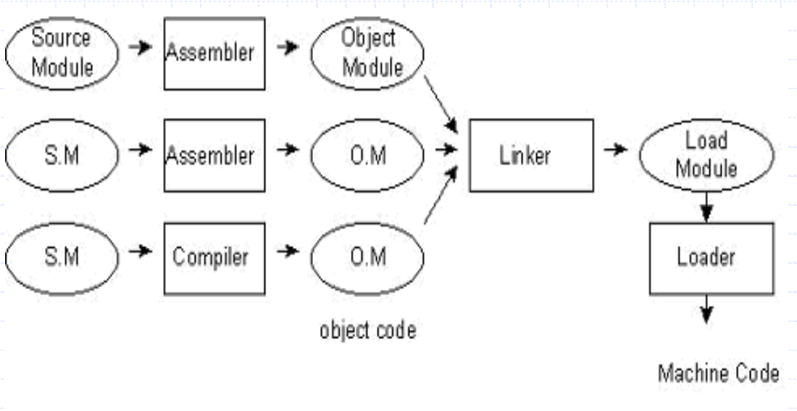
Background Study
The basic assembler functions are:
Translating mnemonic language code to its equivalent
object code.
Assigning machine addresses to symbolic labels.
The design of assembler can be to perform the following:
Scanning (tokenizing)
Parsing (validating the instructions)
Creating the symbol table
Resolving the forward references
Converting into the machine language
Fig 3:Step to convert machine code [7]
November 27, 2023 Optimizing CPU Performance through SIMD Array Processing Unit 7/15
7

Slide 9
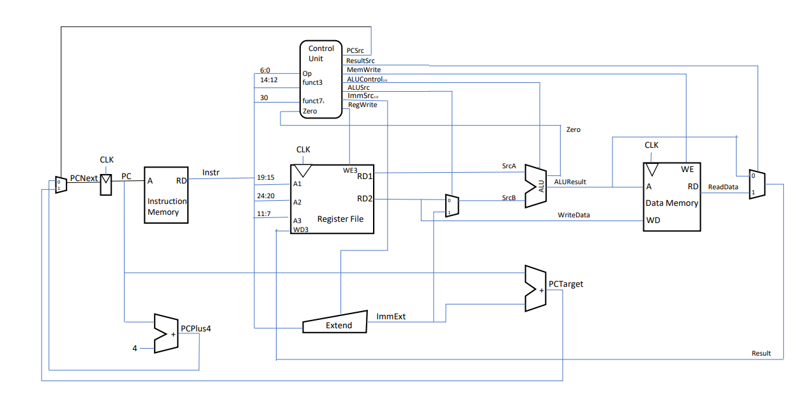
TOP Architecture
Fig 6: RISCV Single Cycle Core
November 27, 2023 Optimizing CPU Performance through SIMD Array Processing Unit 8/15
7

Slide 10
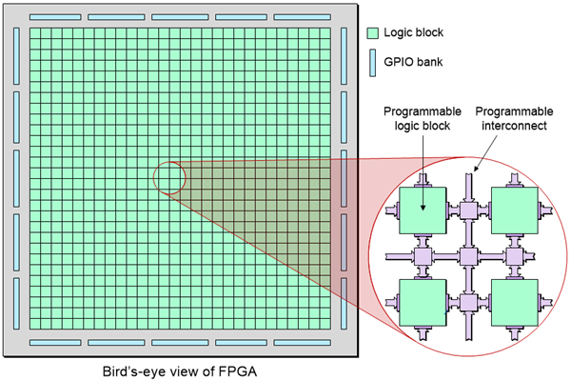
Why FPGA?
Advantages of using FPGA:
Reconfigurable computing.
Low cost.
High density.
High speed.
A large amount of logic gate, register, RAM, routing resources.
It is easy to upgrade like in the case of software.
Unique application.
Fig 4: Bird’s Eye View of FPGA [6]
November 27, 2023 Optimizing CPU Performance through SIMD Array Processing Unit 9/15
7

Slide 11
Proposed methodology
Assembler
Instruction Memory
CPU Array
Data Memory
Bank
Fig 5: Future work.
November 27, 2023 Optimizing CPU Performance through SIMD Array Processing Unit 10/15
7

Slide 12
Tools
❏ Hardware:
FPGA : Xilinx Spartan-6 FPGA
❏ Software:
➔ Visual Studio code
➔ GTK Wave: To verify the testbenches for Verilog modules
➔ Pycharm
❏ Language Support: Verilog Hardware Description Language , Python
November 27, 2023 Optimizing CPU Performance through SIMD Array Processing Unit 11/15
7

Slide 13
Conclusion
we have work on a RISC-V processor.
We have implemented multiple processing unit concept on RISC-V processor as a result we able to reduce execution time.
Now our processor can process multiple instruction at a time.
We also design assembler for this array processor so that user can easily write program for this processor.
November 27, 2023 Optimizing CPU Performance through SIMD Array Processing Unit 12/15
7

Slide 14
Future Scope
Future Scope Of Processor:
We can also design the array-vector hybrid processor .
Future Scope Of Compiler:
Design the assembler with other functionalities also for better performance in future
November 27, 2023 Optimizing CPU Performance through SIMD Array Processing Unit 13/15
7

Slide 15
References
[1] M. H. Banna Saif, N. U. Sadad and M. N. Islam Mondal, "FPGA Implementation of Educational RISC- V Processor Suitable for Embedded Applications," 2023 International Conference on Electrical, Computer and Communication Engineering (ECCE), Chittagong, Bangladesh, 2023, pp. 1-5, doi: 10.1109/ECCE57851.2023.10101508.
[2] M. Johns and T. J. Kazmierski, "A Minimal RISC-V Vector Processor for Embedded Systems," 2020 Forum for Specification and Design Languages (FDL), Kiel, Germany, 2020, pp. 1-4, doi: 10.1109/FDL50818.2020.9232940
[3] Al-sudany, S. M. (2020). FPGA based MIPS Pipeline Processor with SIMD Architecture. International Journal of Science and Research (IJSR), 9(6), 444-450. doi:10.21275/SR20601000556
[4] A. Yıldız, H. F. Ugurdag, B. Aktemur, D. İskender and S. Gören, "CPU design simplified," 2018 3rd International Conference on Computer Science and Engineering (UBMK), Sarajevo, Bosnia and Herzegovina, 2018, pp. 630-632, doi: 10.1109/UBMK.2018.8566475.
November 27, 2023 Optimizing CPU Performance through SIMD Array Processing Unit 14/15
7

Slide 16
References
[5] G. Qin, Y. Hu, L. Huang and Y. Guo, "Design and Performance Analysis on Static and Dynamic Pipelined CPU in Course Experiment of Computer Architecture," 2018 13th International Conference on Computer Science & Education (ICCSE), Colombo, Sri Lanka, 2018, pp. 1-6, doi: 10.1109/ICCSE.2018.8468729.
[6] “What is FPGA—How Does it Work and its Uses”, latticesemi.com. Available: https://www.latticesemi.com/en/What-is-an-FPGA [Accessed: 23-Nov-2023].
[7] https://www.gdeepak.com/course/ss/15ss.pdf. Accesed November 23, 2023.
November 27, 2023 Optimizing CPU Performance through SIMD Array Processing Unit 15/15
7

Slide 17
Md Firoz Al Mamun
Roll: 1703117
Nadim Mahmud Reyal
Roll: 1803116
Thank You
November 27, 2023 Optimizing CPU Performance through SIMD Array Processing Unit
7

